Slide 1

Algebra 1
Unit 13, Lesson 3 Comparing Key Features of Functions Volume 2, pg. 246

Slide 2


Benchmarks
MA.912.F.1.6
Compare key features of linear and nonlinear functions each represented algebraically, graphically, in tables, or written descriptions.
MA.912.F.1.8
Determine whether a linear, quadratic, or exponential function best models a given real-world situation.
volume 2, pg. 246

Slide 3
Integrated Mathematical Thinking and Reasoning Standards
MA.K12.MTR.1.1 Actively participate in effortful learning both individually and collectively.
MA.K12.MTR.2.1 Demonstrate understanding by representing problems in multiple ways.
MA.K12.MTR.3.1 Complete tasks with mathematical fluency.
MA.K12.MTR.4.1 Engage in discussions that reflect on the mathematical thinking of self and others.
MA.K12.MTR.5.1 Use patterns and structure to help understand and connect mathematical concepts.
MA.K12.MTR.6.1 Assess the reasonableness of solutions.
MA.K12.MTR.7.1 Apply mathematics to real-world contexts.
volume 2, pg. 246

Slide 4

Learning Targets
I can compare key features of linear and nonlinear functions that are represented algebraically, graphically, in tables, or in written descriptions.
I can verify when a quantity increasing exponentially exceeds a quantity increasing linearly or quadratically.
volume 2, pg. 246

Slide 5

Warm-Up
volume 2, pg. 247

Slide 6
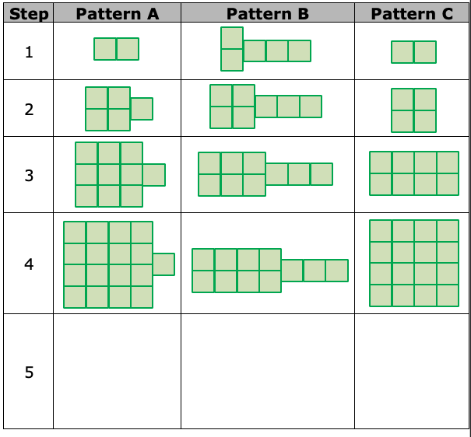
13.3.1 Warm-Up: Tale of Three Patterns
The table shows three different patterns.
volume 2, pg. 247

Slide 7
Write the number of squares needed for step 5 of each pattern.
Which pattern increases the same number of squares for each step?
volume 2, pg. 247

Slide 8

Guided Instruction
volume 2, pg. 247

Slide 9
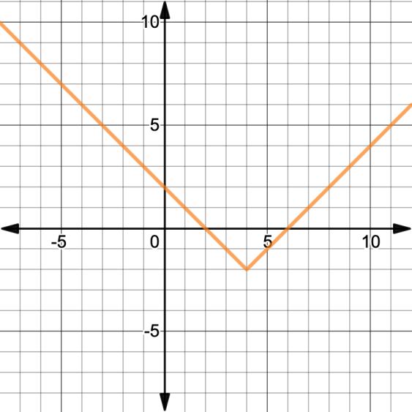
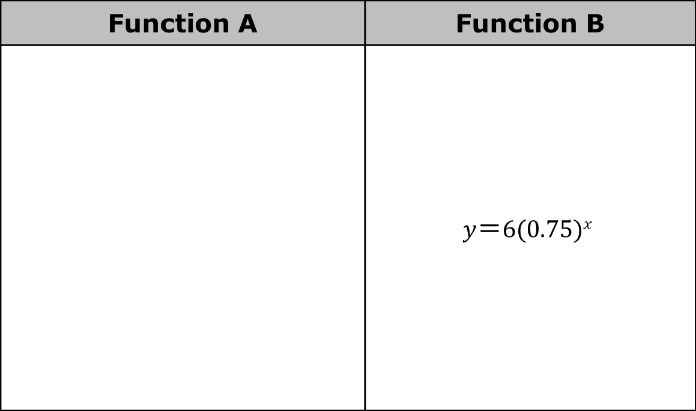
13.3.2 Guided Instruction: Comparing Functions
The table shows two functions.
Function A | Function B
 | $$y＝6(0.75)x$$
volume 2, pg. 247

Slide 10
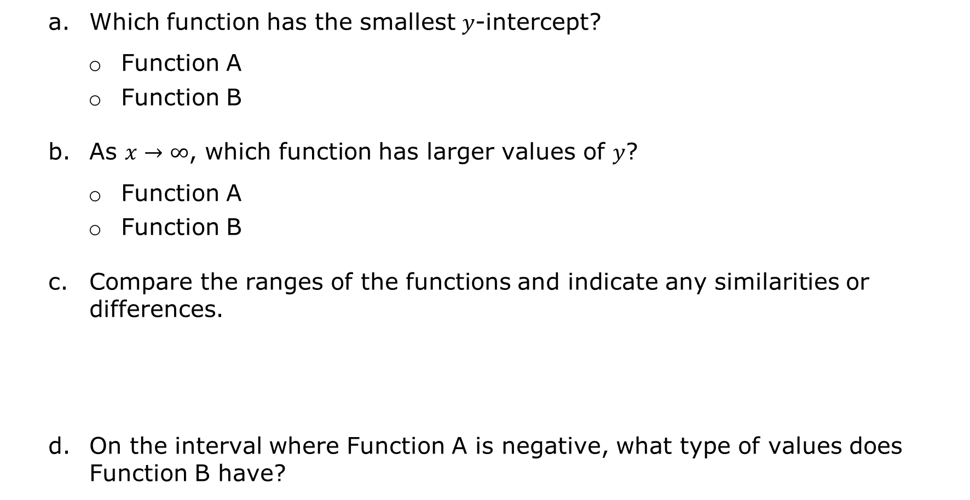
Which function has the smallest $y$-intercept?
Function A
Function B
As $x→∞$, which function has larger values of $y$?
Function A
Function B
Compare the ranges of the functions and indicate any similarities or differences.
On the interval where Function A is negative, what type of values does Function B have?
volume 2, pg. 247/248

Slide 11
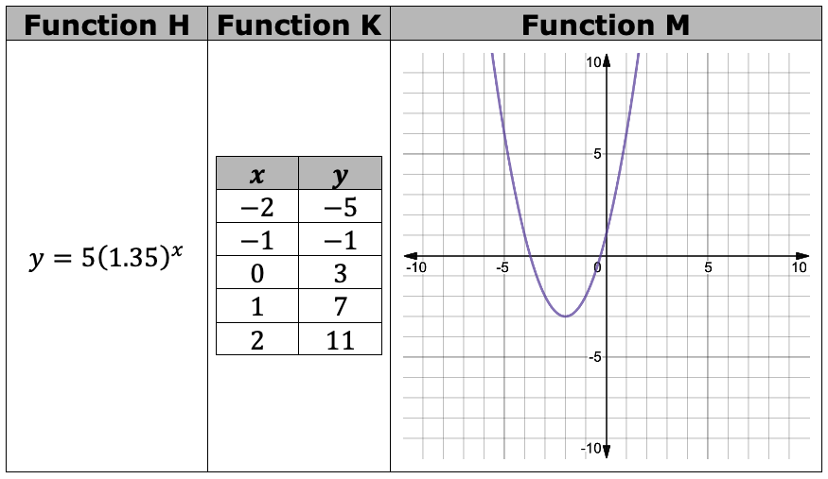
The table shows three different functions.
volume 2, pg. 248

Slide 12
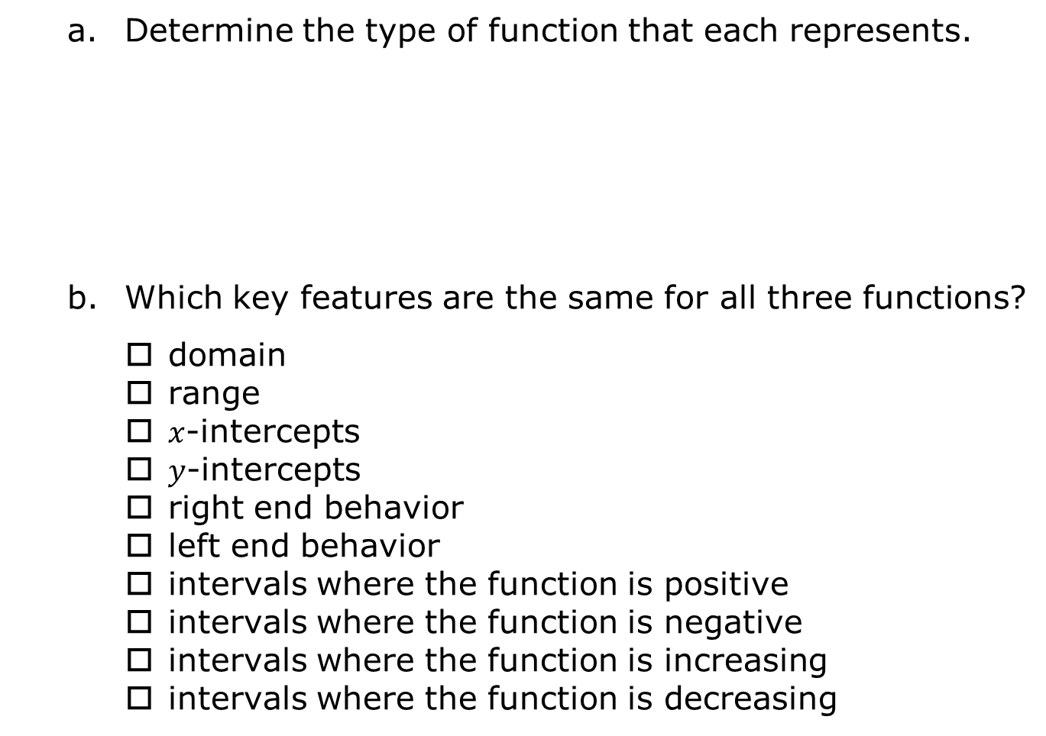
Determine the type of function that each represents.
Which key features are the same for all three functions?
domain
range
$x$-intercepts
$y$-intercepts
right end behavior
left end behavior
intervals where the function is positive
intervals where the function is negative
intervals where the function is increasing
intervals where the function is decreasing
Function H | Function K | Function M
linear quadratic exponential | linear quadratic exponential | linear quadratic exponential
volume 2, pg. 248

Slide 13
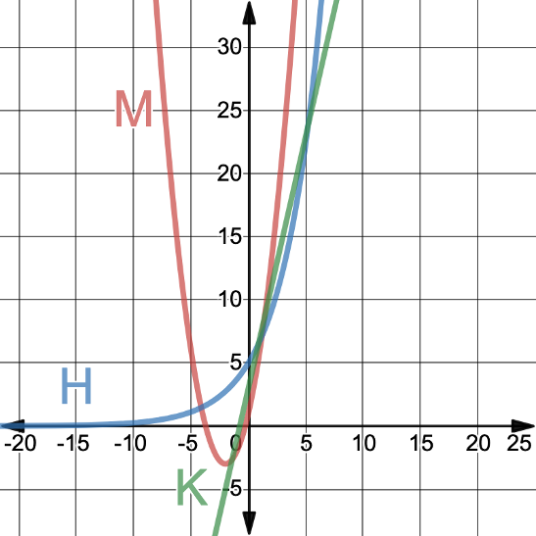
The graph shows Function H, Function K, and Function M.
Which function, H, K, or M, will
eventually exceed the other functions as all the functions
increase?
Function H
Function K
Function M
volume 2, pg. 249

Slide 14
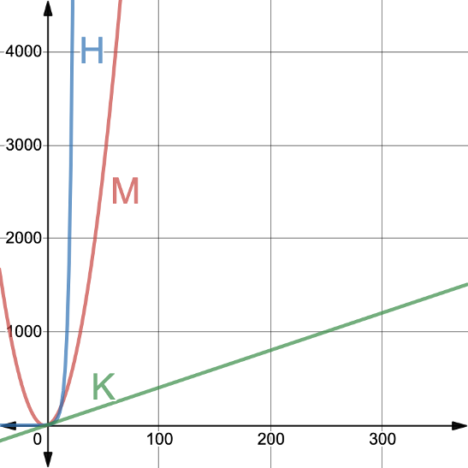
The graph shows Function H, Function K, and Function M using different scales for the axes.
Discuss with your partner whether
or not the graph verifies that the
function you chose in question 3 will eventually exceed the other functions as all the functions
increase. If necessary, adjust
your answer.
volume 2, pg. 249

Slide 15
Comparing simple interest to compound interest is like comparing a linear function to an exponential function. As observed in the previous lesson, the amount of interest accrued with compound interest exceeds simple interest. In the graphs of functions H, K, and M, the quadratic function, M, rises faster than the linear function, K, but it does not rise faster than the exponential function H.
Discuss with your partner why exponential growth will always eventually exceed a parabola that opens up, and a line with a positive slope. Summarize your discussion.
volume 2, pg. 250

Slide 16

Collaboration
volume 2, pg. 250

Slide 17

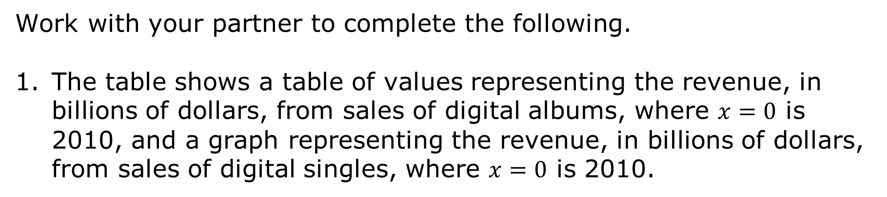
13.3.3 Collaboration: Digital Music Sales
Work with your partner to complete the following.
The table shows a table of values representing the revenue, in billions of dollars, from sales of digital albums, where $x=0$ is 2010, and a graph representing the revenue, in billions of dollars, from sales of digital singles, where $x=0$ is 2010.
volume 2, pg. 250

Slide 18
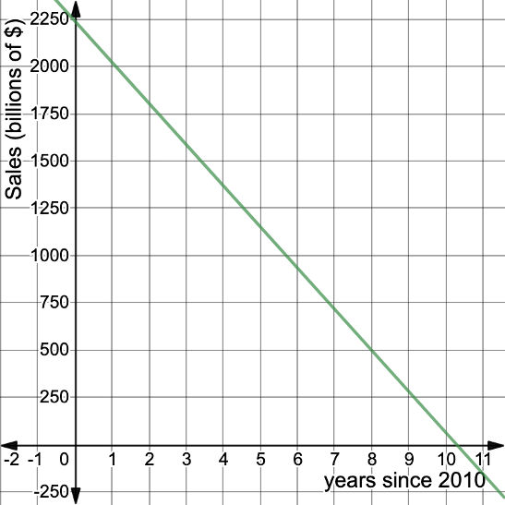
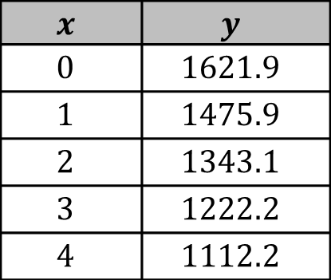
Digital Albums Sales (billions of $) | Digital Singles Sales (billions of $)
$$x$$ | $$y$$
$$0$$ | $$1621.9$$
$$1$$ | $$1475.9$$
$$2$$ | $$1343.1$$
$$3$$ | $$1222.2$$
$$4$$ | $$1112.2$$
volume 2, pg. 250

Slide 19
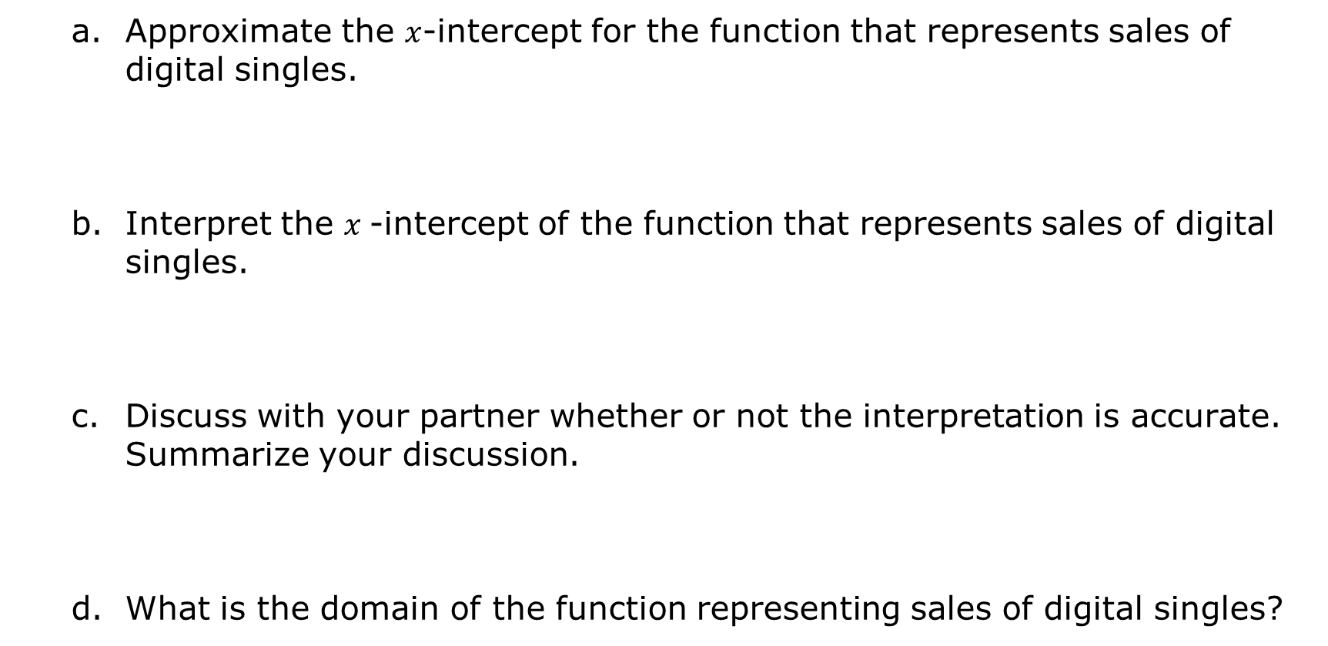
Approximate the $x$-intercept for the function that represents sales of digital singles.
Interpret the $x$-intercept of the function that represents sales of digital singles.
Discuss with your partner whether or not the interpretation is accurate. Summarize your discussion.
What is the domain of the function representing sales of digital singles?
volume 2, pg. 251

Slide 20
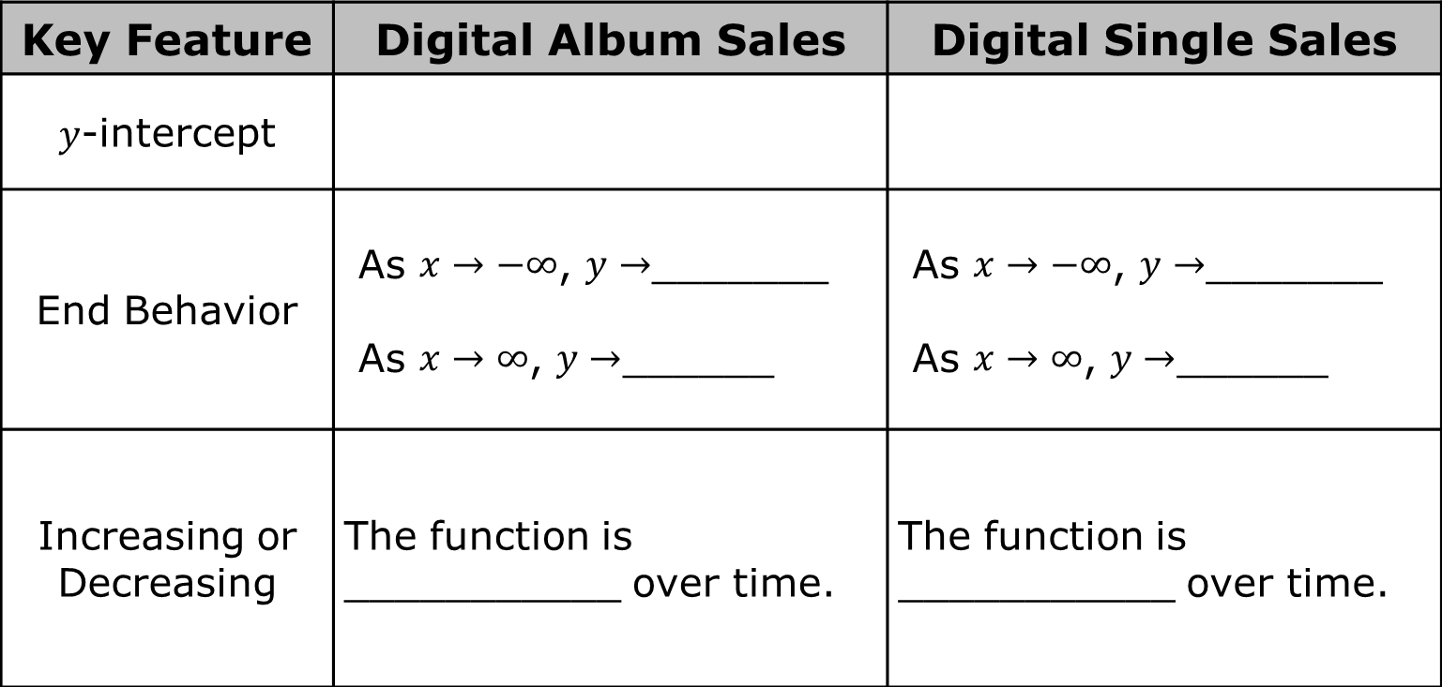
Work with your partner to determine the key features for each function.
Key Feature | Digital Album Sales | Digital Single Sales
$y$-intercept
End Behavior | As $x→−∞$, $y→$_______ As $x→∞$, $y→$______ | As $x→−∞$, $y→$_______ As $x→∞$, $y→$______
Increasing or Decreasing | The function is ___________ over time. | The function is ___________ over time.
volume 2, pg. 251

Slide 21
Discuss with your partner what type of function best describes the table of values that represents the digital album sales. Explain your choice.
linear
quadratic
exponential
volume 2, pg. 251

Slide 22
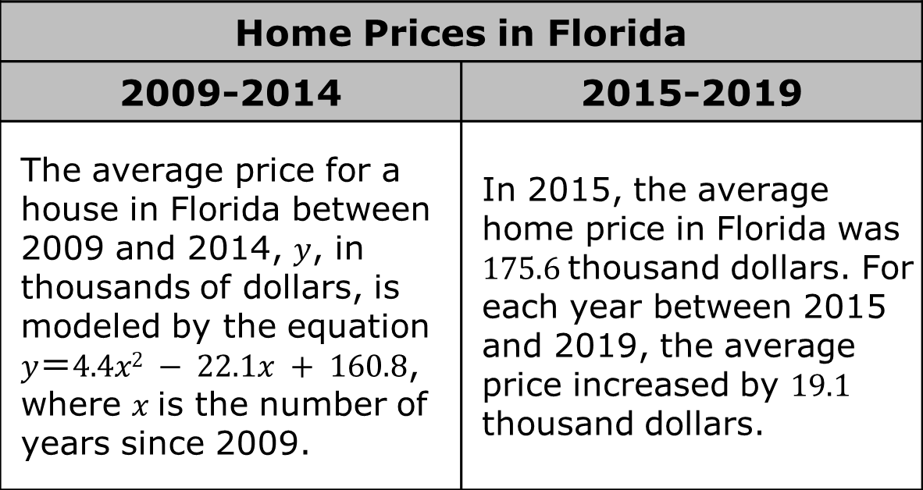
The table shows written descriptions and equations that model the home prices, in thousands of dollars, for two different time periods.
Home Prices in Florida
2009-2014 | 2015-2019
The average price for a house in Florida between 2009 and 2014, $y$, in thousands of dollars, is modeled by the equation $y＝4.4x2 − 22.1x + 160.8$, where $x$is the number of years since 2009. | In 2015, the average home price in Florida was $175.6$thousand dollars. For each year between 2015 and 2019, the average price increased by $19.1$ thousand dollars.
volume 2, pg. 252

Slide 23
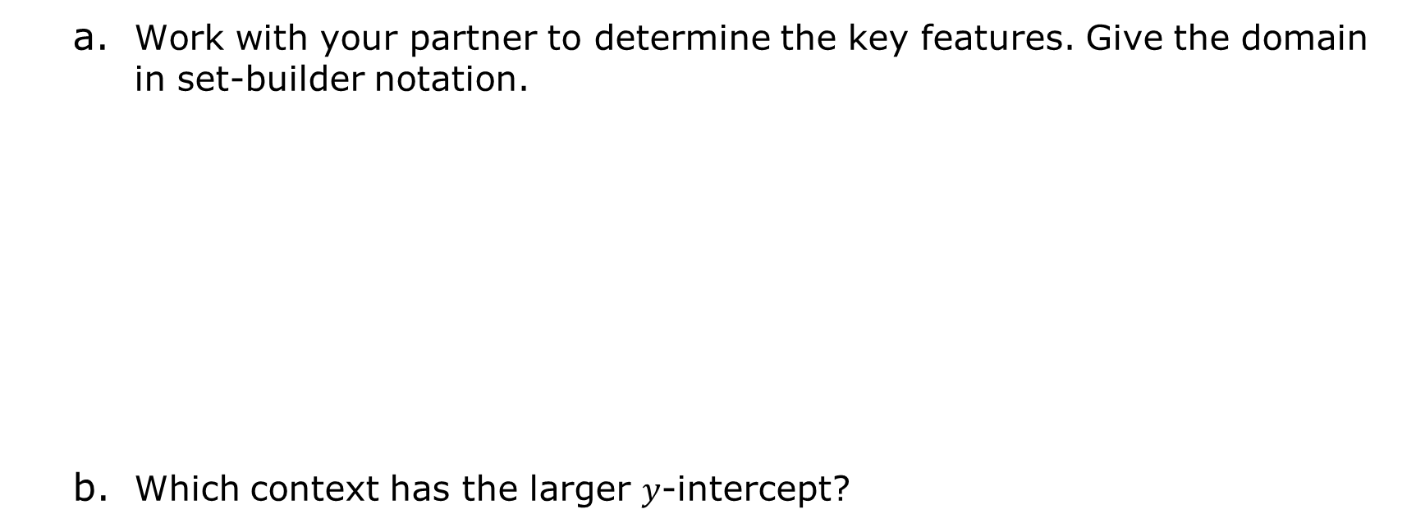
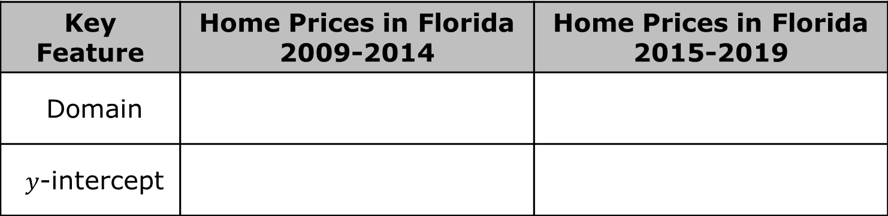
Work with your partner to determine the key features. Give the domain in set-builder notation.
Which context has the larger $y$-intercept?
Key Feature | Home Prices in Florida 2009-2014 | Home Prices in Florida 2015-2019
Domain
$y$-intercept
volume 2, pg. 252

Slide 24
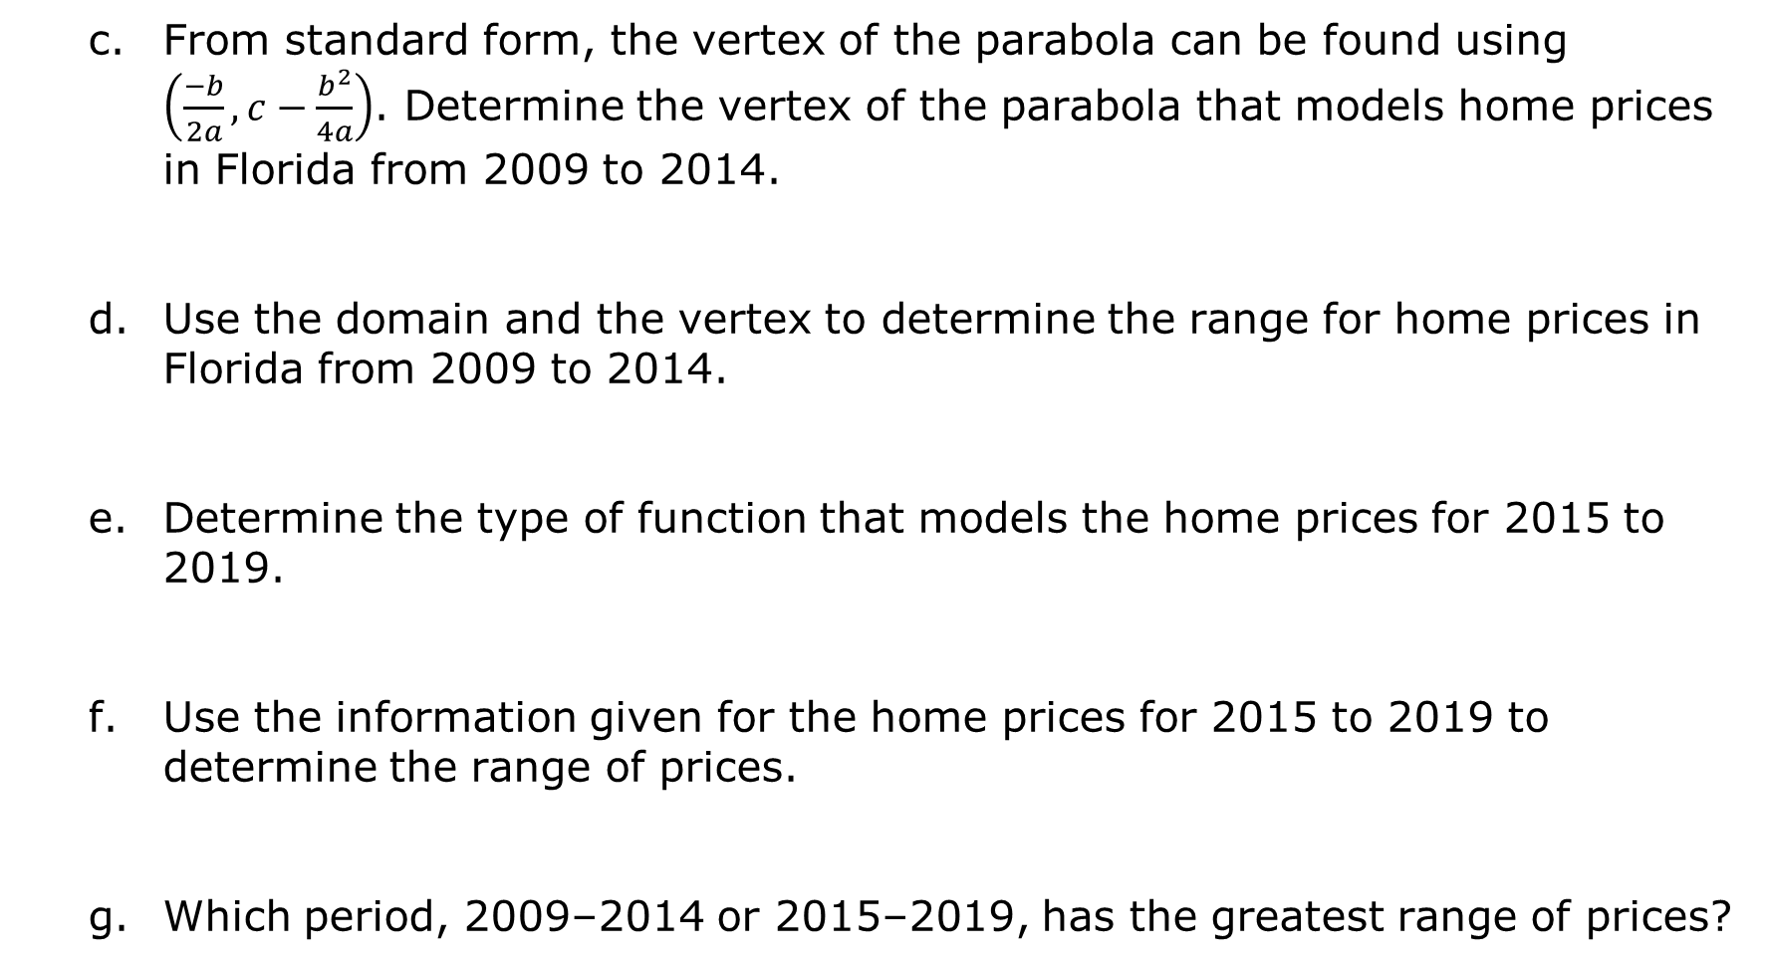
From standard form, the vertex of the parabola can be found using $\left(\frac{−b}{2a}, c−\frac{b^{2}}{4a}\right)$. Determine the vertex of the parabola that models home prices in Florida from 2009 to 2014.
Use the domain and the vertex to determine the range for home prices in Florida from 2009 to 2014.
Determine the type of function that models the home prices for 2015 to 2019.
Use the information given for the home prices for 2015 to 2019 to determine the range of prices.
Which period, 2009–2014 or 2015–2019, has the greatest range of prices?
volume 2, pg. 252

Slide 25

Wrap-Up
volume 2, pg. 253

Slide 26
13.3.4 Wrap-Up: Reflection
Complete the table.
The terms and information used in the Guided Instruction and Collaboration that I knew were … | Something I wondered during the Guided Instruction or Collaboration was … | Something I learned during the Guided Instruction or Collaboration was …
volume 2, pg. 253

